Slide 1
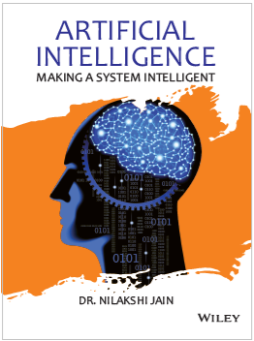
Chapter Eight
Knowledge and reasoning

Slide 2
Learning objectives.
8.1 Knowledge-based agent
8.2 Wumpus world
8.3 Specifying the environment
8.4 What is knowledge representation?
8.5 Knowledge representation issues
After this chapter , students will be able to :
Learn and understand the basic concept of knowledge-based agent
Solve and understand the concept of Wumpus world problem

Slide 3
A knowledge-based agent
8.1 Knowledge-based agent
8.2 Wumpus world
8.3 Specifying the environment
8.4 What is knowledge representation?
8.5 Knowledge representation issues
A knowledge-based agent includes a knowledge base and an inference system.
A knowledge base is a set of representations of facts of the world.
Each individual representation is called a sentence.
The sentences are expressed in a knowledge representation language.
The agent operates as follows:
1. It TELLs the knowledge base what it perceives.
2. It ASKs the knowledge base what action it should perform.
3. It performs the chosen action.

Slide 4
Architecture of a knowledge-based agent
8.1 Knowledge-based agent
8.2 Wumpus world
8.3 Specifying the environment
8.4 What is knowledge representation?
8.5 Knowledge representation issues
Knowledge Level.
The most abstract level: describe agent by saying what it knows.
Example: A taxi agent might know that the Golden Gate Bridge connects San Francisco with the Marin County.
Logical Level.
The level at which the knowledge is encoded into sentences.
Example: Links(GoldenGateBridge, SanFrancisco, MarinCounty).
Implementation Level.
The physical representation of the sentences in the logical level.
Example: ‘(links goldengatebridge sanfrancisco marincounty)

Slide 5
The Wumpus World environment
8.1 Knowledge-based agent
8.2 Wumpus world
8.3 Specifying the environment
8.4 What is knowledge representation?
8.5 Knowledge representation issues
The Wumpus computer game
The agent explores a cave consisting of rooms connected by passageways.
Lurking somewhere in the cave is the Wumpus, a beast that eats any agent that enters its room.
Some rooms contain bottomless pits that trap any agent that wanders into the room.
Occasionally, there is a heap of gold in a room.
The goal is to collect the gold and exit the world without being eaten

Slide 6
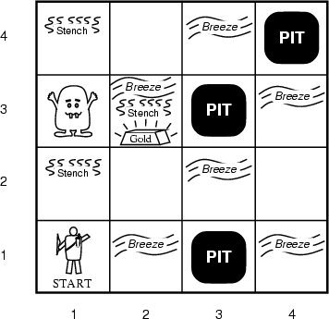
A typical Wumpus world
8.1 Knowledge-based agent
8.2 Wumpus world
8.3 Specifying the environment
8.4 What is knowledge representation?
8.5 Knowledge representation issues
The agent always starts in the field [1,1].
The task of the agent is to find the gold, return to the field [1,1] and climb out of the cave.

Slide 7
Agent in a Wumpus world: Percepts
8.1 Knowledge-based agent
8.2 Wumpus world
8.3 Specifying the environment
8.4 What is knowledge representation?
8.5 Knowledge representation issues
The agent perceives
a stench in the square containing the wumpus and in the adjacent squares (not diagonally)
a breeze in the squares adjacent to a pit
a glitter in the square where the gold is
a bump, if it walks into a wall
a woeful scream everywhere in the cave, if the wumpus is killed
The percepts are given as a five-symbol list. If there is a stench and a breeze, but no glitter, no bump, and no scream, the percept is
[Stench, Breeze, None, None, None]

Slide 8
Wumpus world actions
8.1 Knowledge-based agent
8.2 Wumpus world
8.3 Specifying the environment
8.4 What is knowledge representation?
8.5 Knowledge representation issues
go forward
turn right 90 degrees
turn left 90 degrees
grab: Pick up an object that is in the same square as the agent
shoot: Fire an arrow in a straight line in the direction the agent is facing. The arrow continues until it either hits and kills the wumpus or hits the outer wall. The agent has only one arrow, so only the first Shoot action has any effect
climb is used to leave the cave. This action is only effective in the start square
die: This action automatically and irretrievably happens if the agent enters a square with a pit or a live wumpus

Slide 9
Wumpus goal
8.1 Knowledge-based agent
8.2 Wumpus world
8.3 Specifying the environment
8.4 What is knowledge representation?
8.5 Knowledge representation issues
The agent’s goal is to find the gold and bring it back to the start square as quickly as possible, without getting killed
1000 points reward for climbing out of the cave with the gold
1 point deducted for every action taken
10000 points penalty for getting killed

Slide 10
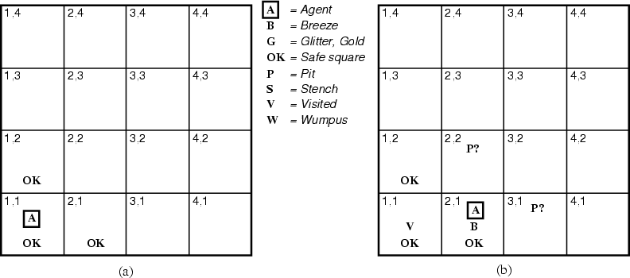
The Wumpus agent’s first step
8.1 Knowledge-based agent
8.2 Wumpus world
8.3 Specifying the environment
8.4 What is knowledge representation?
8.5 Knowledge representation issues
¬W
¬W

Slide 11
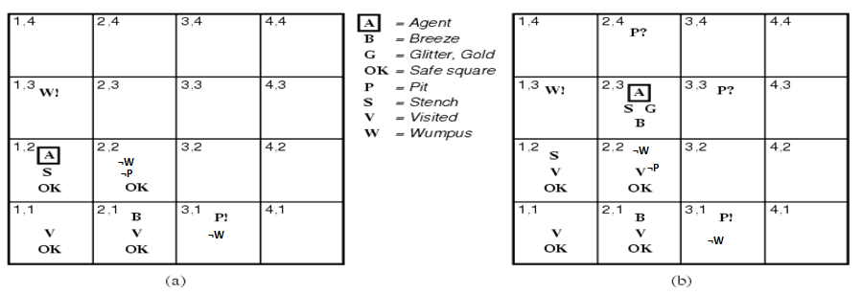
Later
8.1 Knowledge-based agent
8.2 Wumpus world
8.3 Specifying the environment
8.4 What is knowledge representation?
8.5 Knowledge representation issues

Slide 12
Let’s Play!
8.1 Knowledge-based agent
8.2 Wumpus world
8.3 Specifying the environment
8.4 What is knowledge representation?
8.5 Knowledge representation issues

Slide 13
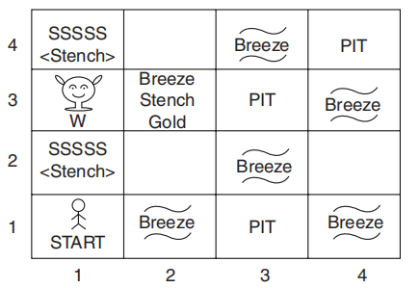
Specifying the environment
8.1 Knowledge-based agent
8.2 Wumpus world
8.3 Specifying the environment
8.4 What is knowledge representation?
8.5 Knowledge representation issues
Like the vacuum world, the Wumpus world is a grid of squares surrounded by walls, where each square can contain agents and objects. The agent always starts in the lower left corner, a square that we will label [1, 1]. The agent’s task is to find the gold, return to [1, 1], and climb out of the cave.
To specify the agent’s task, we specify its performance, environment, actions, sensors [PEAS]. In the Wumpus world, these are as follows:

Slide 14
Specifying the environment
8.1 Knowledge-based agent
8.2 Wumpus world
8.3 Specifying the environment
8.4 What is knowledge representation?
8.5 Knowledge representation issues
Performance measure:
1,000 for picking up the gold.
1000 for falling into a pit or being eaten by Wumpus.
One for each action taken.
10 for using up the arrow.
Environment:
A 4 × 4 grid of rooms.
The agent always starts in the square labeled [1, 1], facing to the right.
The locations of the gold and Wumpus are chosen randomly, with a uniform distribution, from the squares other than the start square.
Each square other than the start can be a pit, with probability 0.2.

Slide 15
Specifying the environment
8.1 Knowledge-based agent
8.2 Wumpus world
8.3 Specifying the environment
8.4 What is knowledge representation?
8.5 Knowledge representation issues
Actuators:
The agent can move forward.
Turn left by 90°.
The agent dies a miserable death if it enters a square containing a pit or a live Wumpus (it is safe, albeit smelly, to enter a square with a dead Wumpus). Moving forward has no effect if there is a wall in front of the agent.
The action grab can be used to pick up an object that is in the same square as the agent.
The action shoot can be used to fire an arrow in straight line in the direction the agent is facing. The arrow continues until it either hits (and hence kills) the Wumpus or hits a wall. The agent only has one arrow, so only first shoot action has any effect.

Slide 16
Specifying the environment
8.1 Knowledge-based agent
8.2 Wumpus world
8.3 Specifying the environment
8.4 What is knowledge representation?
8.5 Knowledge representation issues
Sensors:
The agent has five sensors, each of which gives a single bit of information.
In the square containing the Wumpus and in the directly (not diagonally) adjacent squares, the agent will perceive a stench.
In the squares directly adjacent to pit, the agent will perceive a breeze.
In the square where the gold is, the agent will perceive a glitter.
When an agent walks into a wall, it will perceive a bump.
When the Wumpus is killed, it emits a woeful scream that can be perceived anywhere in the cave.
The percepts will be given to the agent in the form of list of five symbols; for example, if there is a stench and a breeze, but no glitter, bump, or scream, the agent will receive the percept

Slide 17
Specifying the environment
8.1 Knowledge-based agent
8.2 Wumpus world
8.3 Specifying the environment
8.4 What is knowledge representation?
8.5 Knowledge representation issues
The following are the properties of task environment:
Partially observable
Deterministic
Sequential (need to remember state)
Static
Discrete
Single agent (Wumpus is not treated as separate agent)

Slide 18
Representation
8.1 Knowledge-based agent
8.2 Wumpus world
8.3 Specifying the environment
8.4 What is knowledge representation?
8.5 Knowledge representation issues
AI agents deal with knowledge (data)
Facts (believe & observe knowledge)
Procedures (how to knowledge)
Meaning (relate & define knowledge)
Right representation is crucial
Early realisation in AI
Wrong choice can lead to project failure
Active research area

Slide 19
Choosing a Representation
8.1 Knowledge-based agent
8.2 Wumpus world
8.3 Specifying the environment
8.4 What is knowledge representation?
8.5 Knowledge representation issues
For certain problem solving techniques
‘Best’ representation already known
Often a requirement of the technique
Or a requirement of the programming language (e.g. Prolog)
Examples
First order theorem proving… first order logic
Inductive logic programming… logic programs
Neural networks learning… neural networks
Some general representation schemes
Suitable for many different (and new) AI applications

Slide 20
Some General Representations
8.1 Knowledge-based agent
8.2 Wumpus world
8.3 Specifying the environment
8.4 What is knowledge representation?
8.5 Knowledge representation issues
Logical Representations
Production Rules
Semantic Networks
Conceptual graphs, frames
Description Logics (see textbook)

Slide 21
What is a Logic?
8.1 Knowledge-based agent
8.2 Wumpus world
8.3 Specifying the environment
8.4 What is knowledge representation?
8.5 Knowledge representation issues
A language with concrete rules
No ambiguity in representation (may be other errors!)
Allows unambiguous communication and processing
Very unlike natural languages e.g. English
Many ways to translate between languages
A statement can be represented in different logics
And perhaps differently in same logic
Expressiveness of a logic
How much can we say in this language?
Not to be confused with logical reasoning
Logics are languages, reasoning is a process (may use logic)

Slide 22
Syntax and Semantics
8.1 Knowledge-based agent
8.2 Wumpus world
8.3 Specifying the environment
8.4 What is knowledge representation?
8.5 Knowledge representation issues
Syntax
Rules for constructing legal sentences in the logic
Which symbols we can use (English: letters, punctuation)
How we are allowed to combine symbols
Semantics
How we interpret (read) sentences in the logic
Assigns a meaning to each sentence
Example: “All lecturers are seven foot tall”
A valid sentence (syntax)
And we can understand the meaning (semantics)
This sentence happens to be false (there is a counterexample)

Slide 23

Propositional Logic
8.1 Knowledge-based agent
8.2 Wumpus world
8.3 Specifying the environment
8.4 What is knowledge representation?
8.5 Knowledge representation issues
Syntax
Propositions, e.g. “it is wet”
Connectives: and, or, not, implies, iff (equivalent)
Brackets, T (true) and F (false)
Semantics (Classical AKA Boolean)
Define how connectives affect truth
“P and Q” is true if and only if P is true and Q is true
Use truth tables to work out the truth of statements

Slide 24
Predicate Logic
8.1 Knowledge-based agent
8.2 Wumpus world
8.3 Specifying the environment
8.4 What is knowledge representation?
8.5 Knowledge representation issues
Propositional logic combines atoms
An atom contains no propositional connectives
Have no structure (today_is_wet, john_likes_apples)
Predicates allow us to talk about objects
Properties: is_wet(today)
Relations: likes(john, apples)
True or false
In predicate logic each atom is a predicate
e.g. first order logic, higher-order logic

Slide 25
First Order Logic
8.1 Knowledge-based agent
8.2 Wumpus world
8.3 Specifying the environment
8.4 What is knowledge representation?
8.5 Knowledge representation issues
More expressive logic than propositional
Used in this course (Lecture 6 on representation in FOL)
Constants are objects: john, apples
Predicates are properties and relations:
likes(john, apples)
Functions transform objects:
likes(john, fruit_of(apple_tree))
Variables represent any object: likes(X, apples)
Quantifiers qualify values of variables
True for all objects (Universal): ∀X. likes(X, apples)
Exists at least one object (Existential): ∃X. likes(X, apples)

Slide 26
Example: FOL Sentence
8.1 Knowledge-based agent
8.2 Wumpus world
8.3 Specifying the environment
8.4 What is knowledge representation?
8.5 Knowledge representation issues
“Every rose has a thorn”
For all X
if (X is a rose)
then there exists Y
(X has Y) and (Y is a thorn)

Slide 27
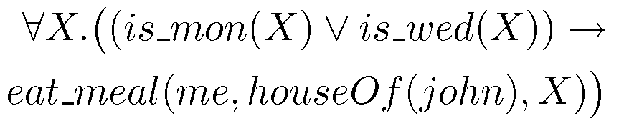
Example: FOL Sentence
8.1 Knowledge-based agent
8.2 Wumpus world
8.3 Specifying the environment
8.4 What is knowledge representation?
8.5 Knowledge representation issues
“On Mondays and Wednesdays I go to John’s house for dinner”
Note the change from “and” to “or”
Translating is problematic

Slide 28

Higher Order Logic
8.1 Knowledge-based agent
8.2 Wumpus world
8.3 Specifying the environment
8.4 What is knowledge representation?
8.5 Knowledge representation issues
More expressive than first order.
Functions and predicates are also objects
Described by predicates: binary(addition)
Transformed by functions: differentiate(square)
Can quantify over both
E.g. define red functions as having zero at 17
Much harder to reason with.

Slide 29
Beyond True and False
8.1 Knowledge-based agent
8.2 Wumpus world
8.3 Specifying the environment
8.4 What is knowledge representation?
8.5 Knowledge representation issues
Multi-valued logics
More than two truth values
e.g., true, false & unknown
Fuzzy logic uses probabilities, truth value in [0,1]
Modal logics
Modal operators define mode for propositions
Epistemic logics (belief)
e.g. p (necessarily p), p (possibly p), …
Temporal logics (time)
e.g. p (always p), p (eventually p), …

Slide 30
Logic is a Good Representation
8.1 Knowledge-based agent
8.2 Wumpus world
8.3 Specifying the environment
8.4 What is knowledge representation?
8.5 Knowledge representation issues
Fairly easy to do the translation when possible
Branches of mathematics devoted to it
It enables us to do logical reasoning
Tools and techniques come for free
Basis for programming languages
Prolog uses logic programs (a subset of FOL)
λProlog based on HOL

Slide 31
Representation & Logic
8.1 Knowledge-based agent
8.2 Wumpus world
8.3 Specifying the environment
8.4 What is knowledge representation?
8.5 Knowledge representation issues
AI wanted “non-logical representations”
Production rules
Semantic networks
Conceptual graphs, frames
But all can be expressed in first order logic!
Best of both worlds
Logical reading ensures representation well-defined
Representations specialised for applications
Can make reasoning easier, more intuitive

Slide 32
8.1 Knowledge-based agent
8.2 Wumpus world
8.3 Specifying the environment
8.4 What is knowledge representation?
8.5 Knowledge representation issues
Knowledge representation issue
The issues that arise during victimization of KR techniques are several. Some of these are explained in the following:
Important attributes: There are attributes that are of general significance. There are two unit attributes, “instance” and “isa”, that are of general importance. These attributes are important as they support property inheritance.

Slide 33
Knowledge representation issue
8.1 Knowledge-based agent
8.2 Wumpus world
8.3 Specifying the environment
8.4 What is knowledge representation?
8.5 Knowledge representation issues
2. Relationship among attributes:
he relationship between the attributes of associate object, freelance of specific data they cipher, could hold properties like inverses, existence in associate “isa” hierarchy, techniques for reasoning regarding values and single valued attributes.
Inverses
Existence in an “isa” hierarchy:
Techniques for reasoning about values:
Single valued attributes:
3. Choosing granularity: High-level facts might not be adequate for illustration, whereas low-level primitives might need heaps of storage.

Slide 34
Knowledge representation issue
8.1 Knowledge-based agent
8.2 Wumpus world
8.3 Specifying the environment
8.4 What is knowledge representation?
8.5 Knowledge representation issues
4. Set of object: The reason to represent sets of objects is described as follows. If a property is true for all or most components of a group, then it is more efficient to associate it once with the set rather than to associate it with each component of the set. This is done in different ways: in logical illustration through the utilization of quantifier, and in hierarchal structure wherever node represents sets, the inheritance propagates set level assertion down to individual.
5. Finding right structure: we have access to right structure for describing a specific state of affairs. It needs to choose associated initial structure so to reduce the selection.

Slide 35
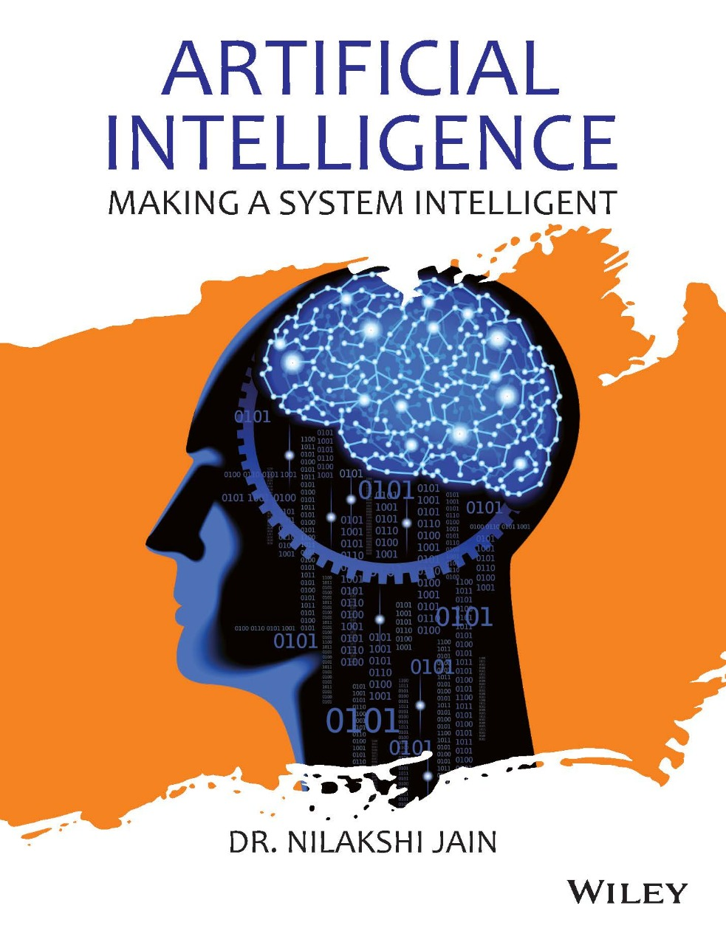
Dr. Nilakshi Jain Email ID : nilakshijain1986@gmail.com
Thank you

